Slide 1
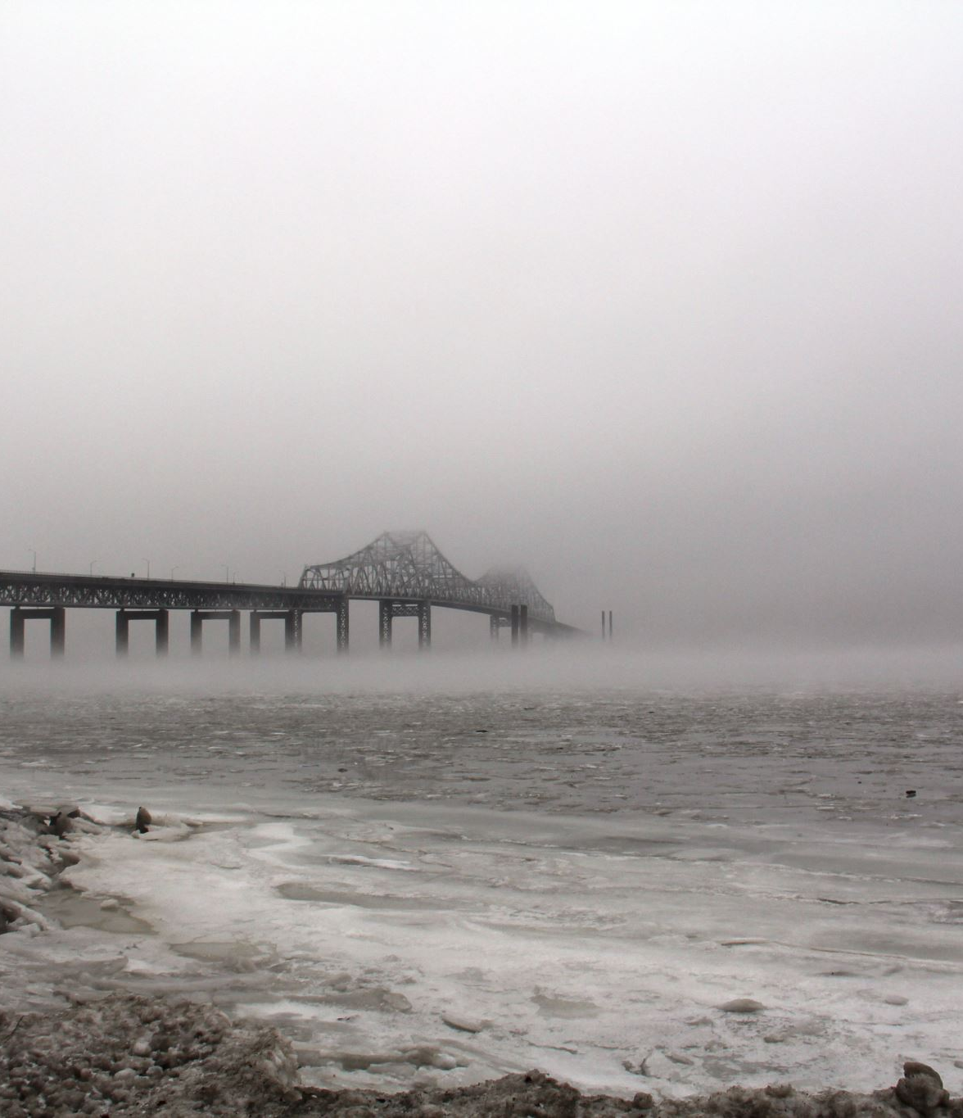
BLACK ‘N WHITE image to color using AI
By –
Hitesh
Sunidhi
Srishti
Mehul

Slide 2
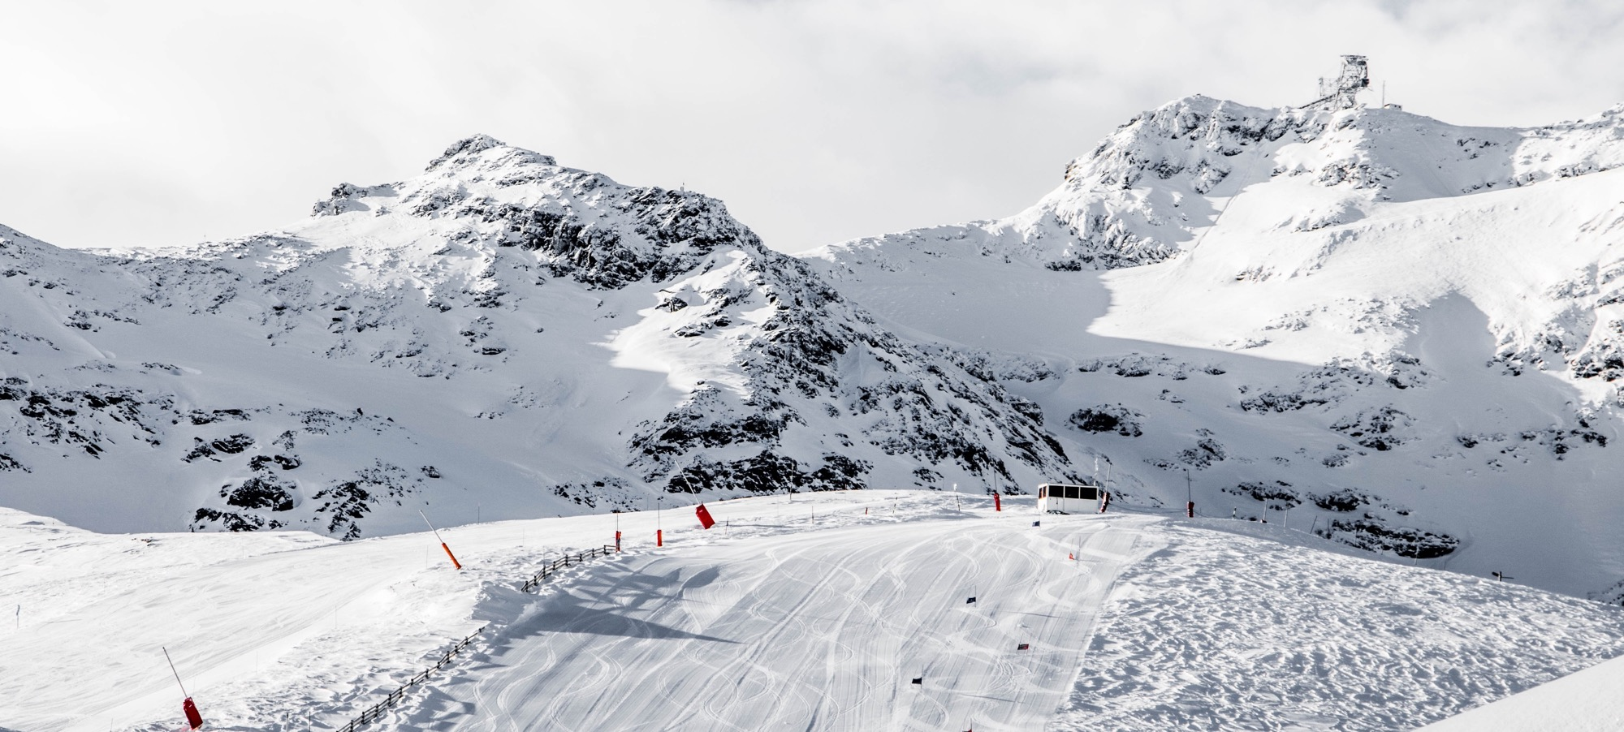
Objective: To get color images from black -n- white.
Notes:
© Copyright Showeet.com – Free PowerPoint Templates

Slide 3
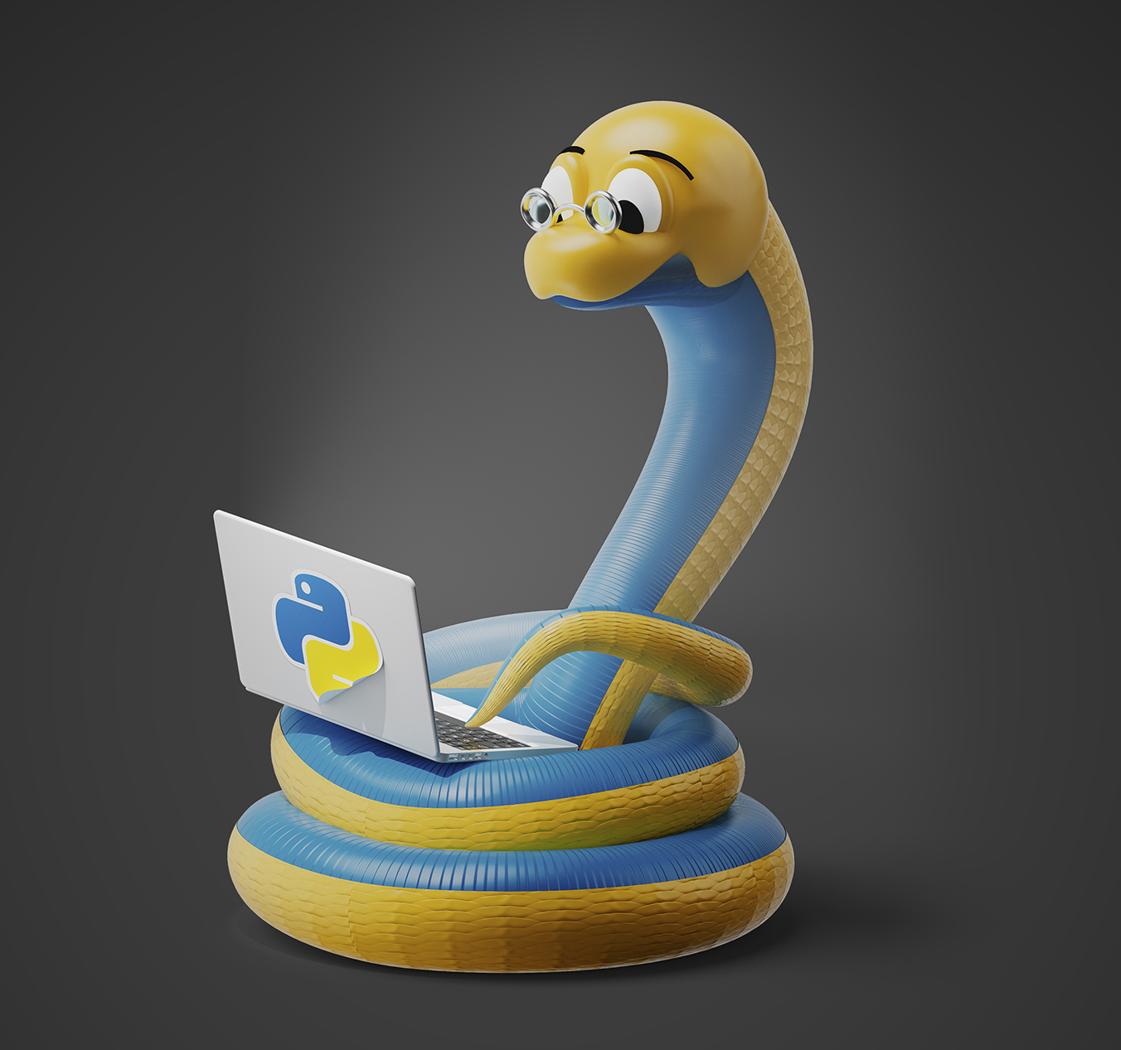
Software Used: Google Colab Platform - Python Programming Language
Notes:
© Copyright Showeet.com – Free PowerPoint Templates

Slide 4
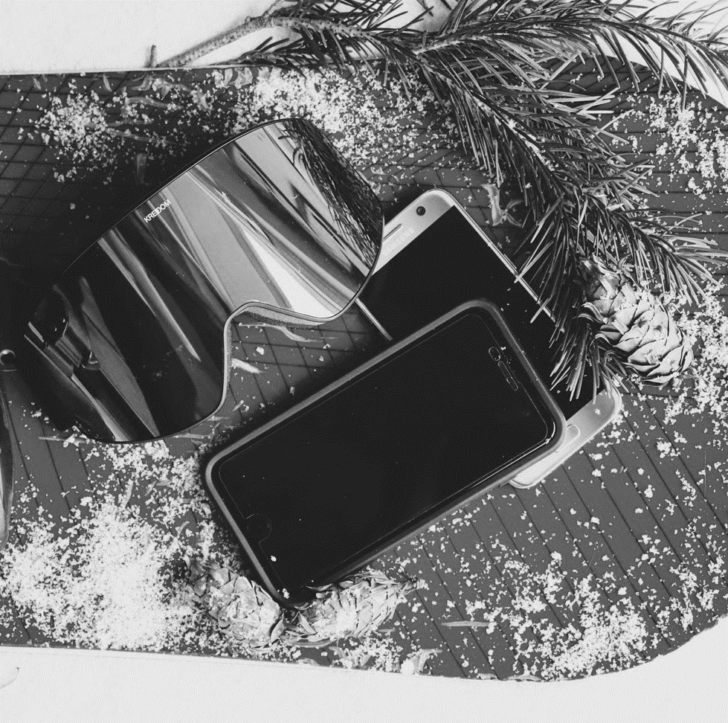
Proposed method:
The proposed method uses the DeOldify python library. DeOldify is a Black and White image Colorizing library created by Jason Antic. Mainly, this library utilized the techniques of these two papers: Self-Attention Generative Adversarial Network and Two Time-Scale Update Rule. Also, DeOldify introduced the NoGAN technique to solve some of the key problems to make hyper-realistic colorization images and video, and we will see everything in our further article section with python code implementation of coloring black and white images and videos with different models.
Notes:
© Copyright Showeet.com – Free PowerPoint Templates

Slide 5
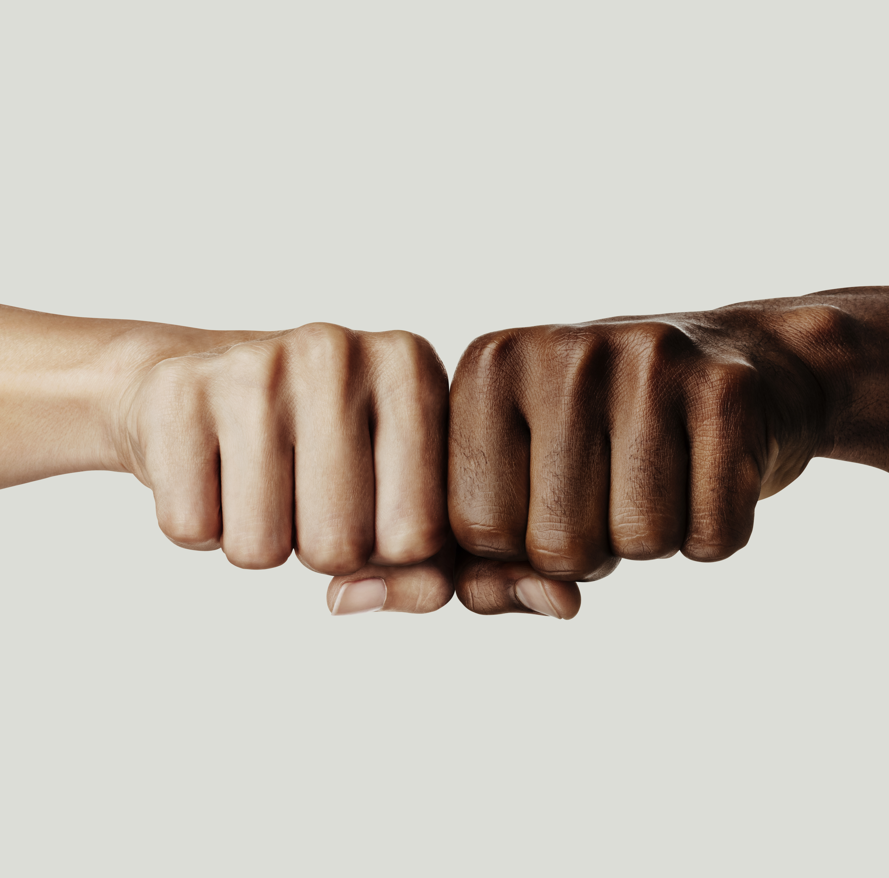
ARCHITECHTURE of Deoldify module
The author uses the following deep learning concepts in these models. These concepts are:
Self-attention: The authors use U-Net architecture for the generator, they also modified the architecture to use Spectral Normalization and self-attention in the model.
Two-Time Scale Update Rule: It is a way of training the GAN architecture. It’s just one to one generator/critic architecture and a higher critic learning rate. This is modified to incorporate a threshold critic loss that makes sure that the critic is “caught up” before moving on to generator training. This is particularly useful for NoGAN training.
Notes:
© Copyright Showeet.com – Free PowerPoint Templates

Slide 6
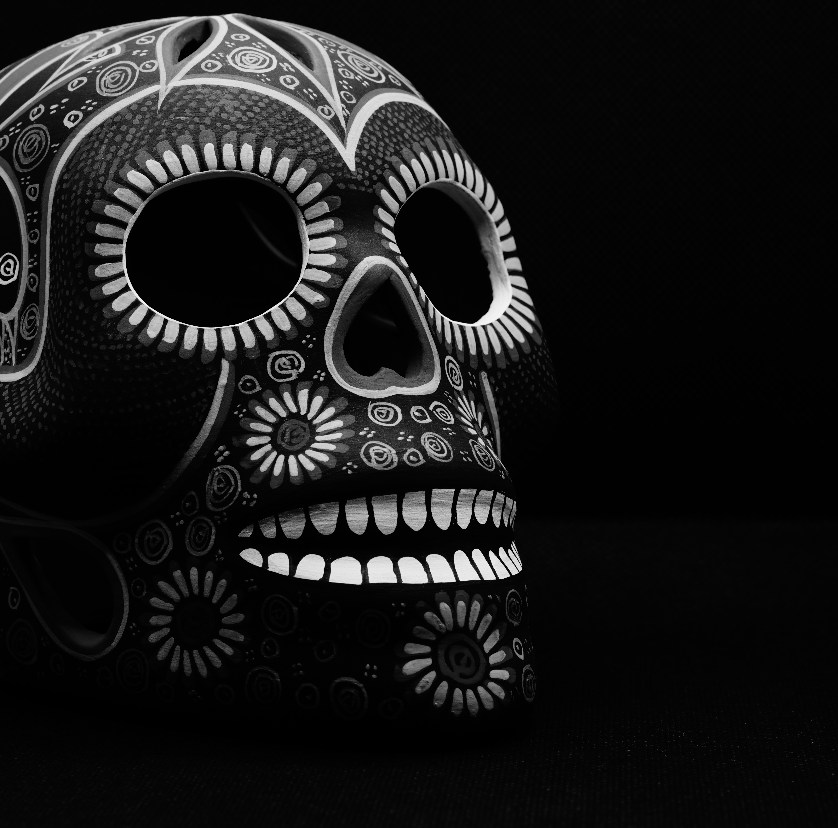
NO-GAN
No-GAN: This method of GAN training is developed by the authors of the model. The main idea behind that model that you get the benefits of GAN training while spending minimal time doing direct GAN training. We will discuss NoGAN in more detail.Generator Loss: There are two types of NoGAN learning in the generator:
Perpetual Loss: This loss is used in the generator to report and minimize the losses generated due to bias in the model.
Critic Loss: It is loss used in the discriminator/critic.
No-GANThis is a new type of GAN training that is developed by the authors of Deoldify. It provides the benefits of GAN training while spending minimal time doing direct GAN training. Instead, we spent most time training generator and critic separately with more straight-forward, fast, and reliable conventional methods.The steps are as follows:
First, we train the generator in a conventional way by itself with just the feature loss.Next, we generate images from the trained generator and train the critic on distinguishing between those outputs and real images as a basic binary classifier.Finally, train the generator and critic together in a GAN setting (starting right at the target size of 192px in this case).
Notes:
© Copyright Showeet.com – Free PowerPoint Templates

Slide 7
DeOldify provides three primary models for different use case. Each of these has some limitations and benefit:
Artistic Model
This model achieves vibrant color and detailed images, but you have to adjust the parameters a lot to get the best results. You have to adjust the rendering resolution and factors to get the most accurate colorize image.
The model uses a resnet34 backbone on a UNet with an emphasis on the depth of layers on the decoder side. And it is trained on five critic pretrain/GAN cycle repeats via NoGAN.
Stable Model
This model archives the best results in portraits and landscapes. It makes sure nothing got too much colored and makes the most part of the image remain gray like faces and limbs. It is less hyper-realistic but it makes sure nothing looks more colored.
It uses a resnet101 backbone on a UNet with an emphasis on the width of layers on the decoder side.
Video Model
As the name suggests, it is a model used to color the videos and we are going to see each of these models working in a python environment. It gives smooth, consistent, and flicker-free Video. This model is the same as a stable model in the case of architecture but different in training. DeOldify is trained on 2.2% of Imagenet dataset once at 192px, using only the initial generator/critic pretrain/GAN NoGAN training.
Notes:
© Copyright Showeet.com – Free PowerPoint Templates

Slide 8
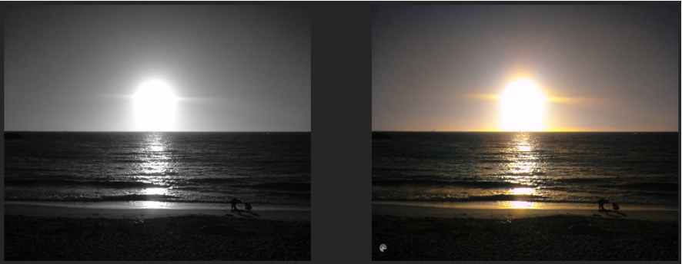
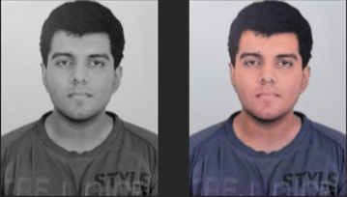
Result:

Slide 9
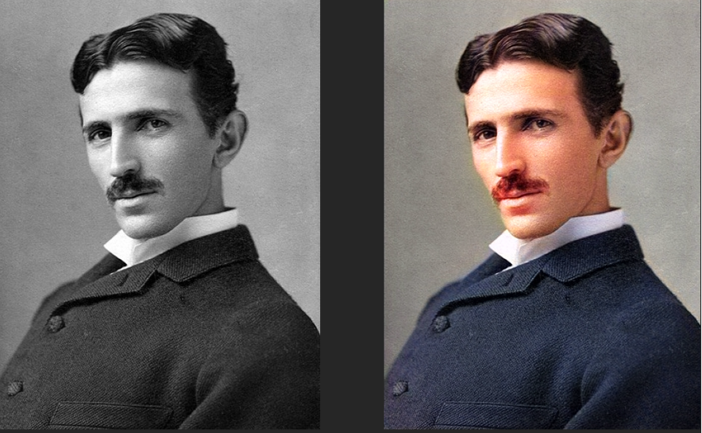
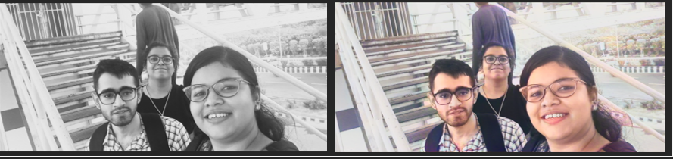
Result:

Slide 10
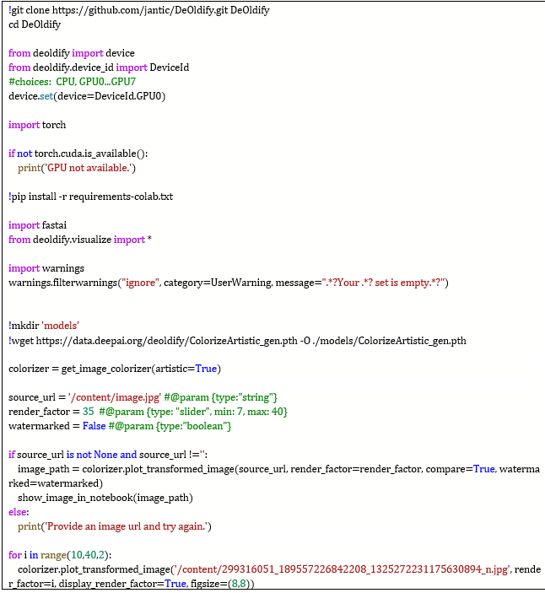

Slide 11
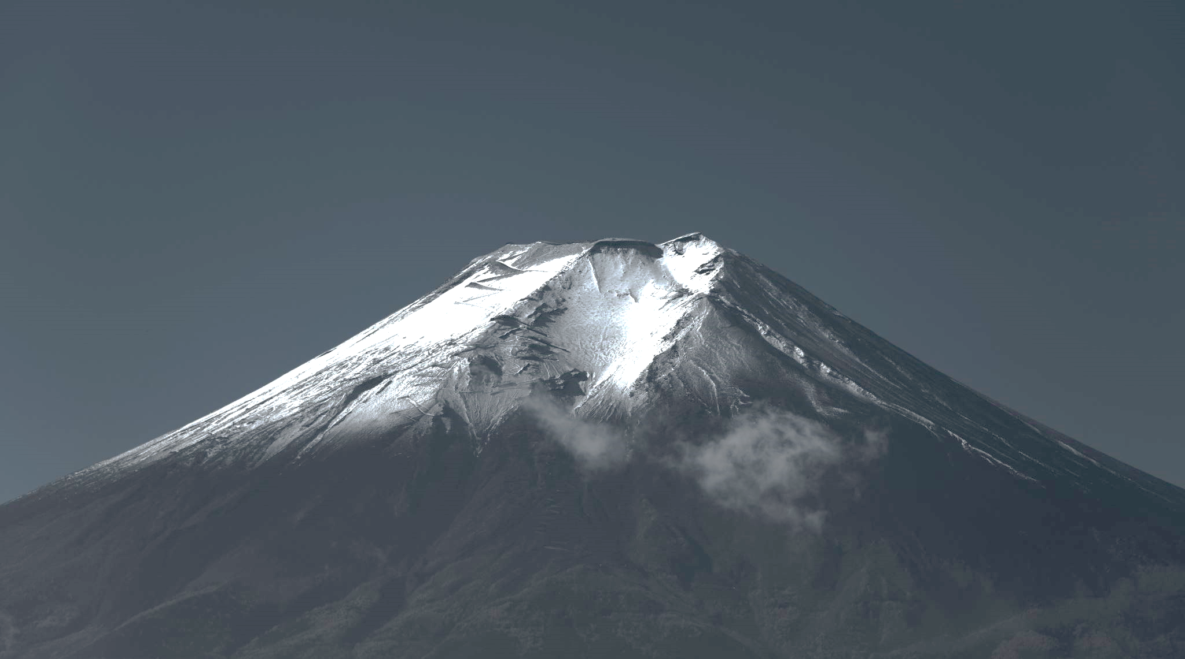
Large Image slide
THANK YOU
Notes:
© Copyright Showeet.com – Free PowerPoint Templates

